Slide 1
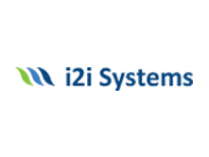
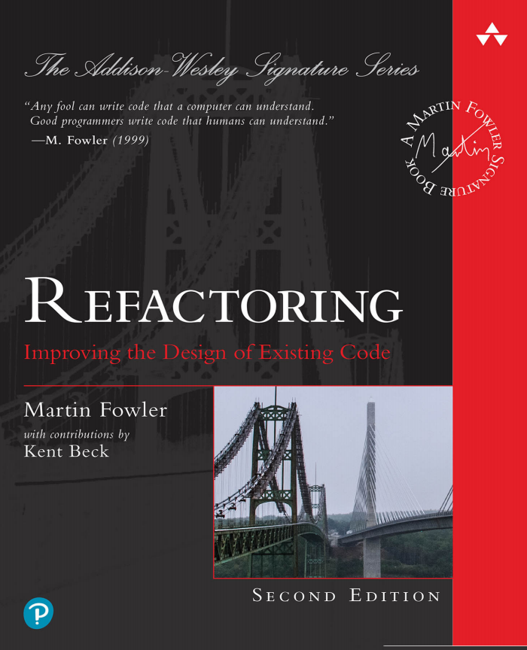
Bad Smells In Code(Chapter 3) Building Tests(Chapter 4) Introducing The Catalog(Chapter 5)
Dilan Kavak
11.08.2021

Slide 2
CONTENTS
Bad Smells In Code
Building Tests
Introducing The Catalog

Slide 3
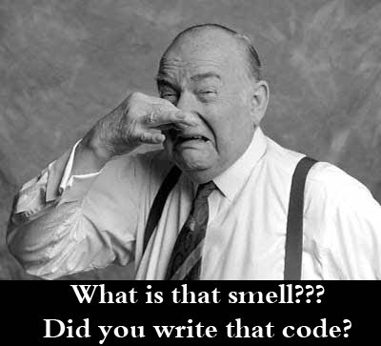

Slide 4
BAD SMELLS IN CODE
Bad Smell is a term that has been used for messy or dirty coding, this term says there is part of the code which needs to be clean in term of future.
The code we are working on may have some nasty smells that make us feel the need to refactor.
These odors usually do not prevent the program from running, but they indicate weaknesses in the project that can slow down development and increase the risk of future errors or failures.

Slide 5
MYSTERIOUS NAME
Puzzling over some text to understand what’s going on is a great thing if you’re reading a detective novel, but not when you’re reading the code.
Naming is one of the two hard things in programming.
So, perhaps the most common refactorings we do are the renames.

Slide 6
MYSTERIOUS NAME
People are often afraid to rename things, thinking it’s not worth the trouble, but a good name can save hours of puzzled incomprehension in the future.
Renaming is not just an exercise in changing names.
When you can’t think of a good name for something, it’s often a sign of a deeper design malaise.

Slide 7
DUPLICATED CODE
If you see the same code structure in more than one place, you can be sure that your program will be better if you find a way to unify them.
If you need to replace the duplicated code, find and capture every duplicate.
The simplest duplicated code problem is that you have the same statement in two methods of the same class.

Slide 8
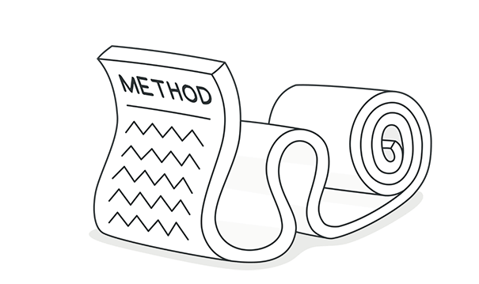
LONG FUNCTION
In our experience, the programs that live best and longest are those with short functions. Programmers new to such a code base often feel that no computation ever takes place — that the program is an endless sequence of delegation.

Slide 9
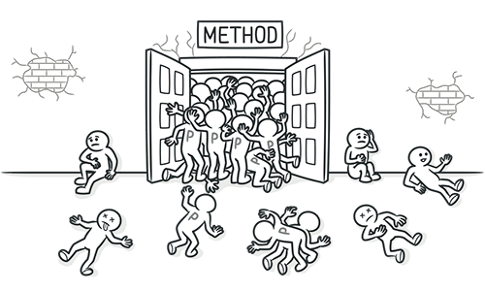
LONG PARAMETER LIST

Slide 10
LONG PARAMETER LIST
In our early programming days, we were taught to pass in as parameters everything needed by a function. This was understandable because the alternative was global data, and global data quickly becomes evil. But long parameter lists are often confusing in their own right.
If a method takes more than three or four parameters, it makes it difficult to understand and increases the bug rate.

Slide 11
GLOBAL DATA
The problem with global data is that it can be modified from anywhere in the code base, and there’s no mechanism to discover which bit of code touched it.
The most obvious form of global data is global variables.
Our key defense here is Encapsulate Variable , which is always our first move when confronted with data that is open to contamination by any part of a program.

Slide 12
MUTABLE DATA
Changes to data can often lead to unexpected consequences and tricky bugs.
Mutable data isn't a big deal when it's a variable whose scope is only a few rows - but the risk increases as its scope grows.

Slide 13
DIVENGENT CHANGE
We structure our software to make change easier; after all, software is meant to be soft. When we make a change, we want to be able to jump to a single clear point in the system and make the change.

Slide 14
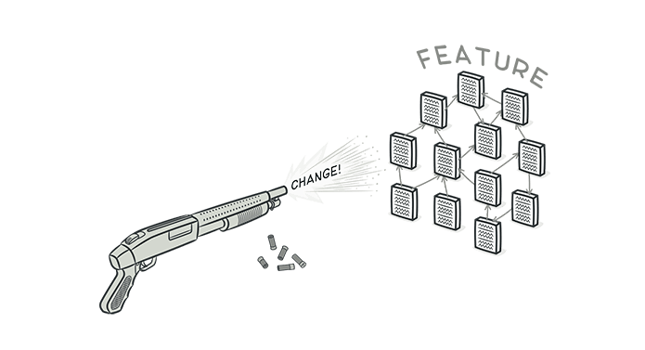
SHOTGUN SURGERY

Slide 15
SHOTGUN SURGERY
Shotgun surgery is similar to divergent change but is the opposite. You whiff this when, every time you make a change, you have to make a lot of little edits to a lot of different classes.
It is the case where when a change is made to the code many minor edits are needed in many different classes.

Slide 16
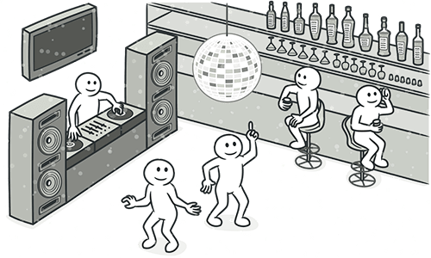
DATA CLUMPS

Slide 17
DATA CLUMPS
Data items tend to be like children: They enjoy hanging around together. Often, you’ll see the same three or four data items together in lots of places: as fields in a couple of classes, as parameters in many method signatures.

Slide 18
PRIMITIVE OBSESSION
Most programming environments are built on a widely used set of primitive types: integers, floating point numbers, and strings. Libraries may add some additional small objects such as dates.
We find many programmers are curiously reluctant to create their own fundamental types which are useful for their domain — such as money, coordinates, or ranges.

Slide 19
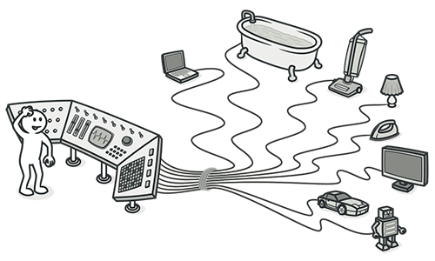
REPEATED SWITCHES
We now focus on the repeated switch, where the same conditional switching logic (either in a switch/case statement or in a cascade of if/else statements) pops up in different places.
The problem with such duplicate switches is that, whenever you add a clause, you have to find all the switches and update them

Slide 20
LOOPS
Loops have been a core part of programming since the earliest languages.
We disdained them at the time of the first edition — but Java, like most other languages at the time, didn’t provide a better alternative. These days, however, first-class functions are widely supported, so we can use Replace Loop with Pipeline.

Slide 21
TEMPORARY FIELD
Sometimes you see a class in which a field is set only in certain circumstances. Such code is difficult to understand because you expect an object to need all of its fields.

Slide 22
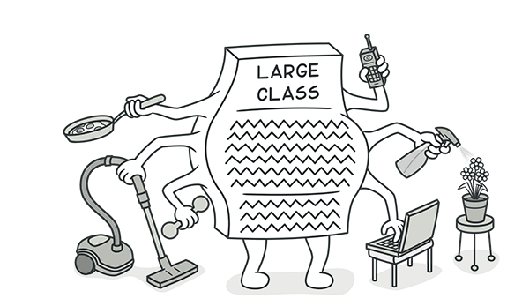
LARGE CLASS
If a class contains many fields / functions / lines of code, the relevant modules of that class should be extracted (Extract class).

Slide 23
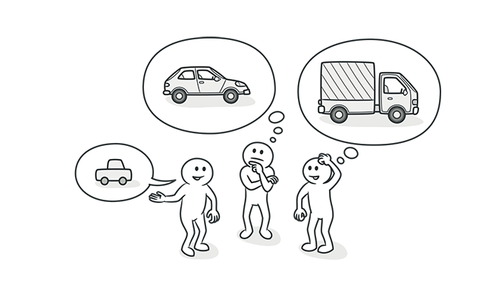
ALTERNATIVE CLASSES WITH DIFFERENT INTERFACES
One of the great benefits of using classes is the support for substitution, allowing one class to swap in for another in times of need. But this only works if their interfaces are the same.

Slide 24
DATA CLASS
These are classes that have fields, getting and setting methods for the fields, and nothing else. Such classes are dumb data holders and are often being manipulated in far too much detail by other classes.

Slide 25
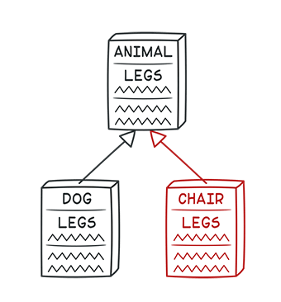
REFUSED BEQUEST
Let's say you have a subclass that inherits from a superclass.
But the subclass doesn't need all the behavior provided by the superclass.
In this case, the subclass rejects some behavior/request of the superclass.

Slide 26
COMMENTS
Comments lead us to bad codex. Our first action is to remove the bad smells by refactoring. When we’re finished, we often find that the comments are superfluous.
When you feel the need to write a comment, first try to refactor the code so that any comment becomes superfluous

Slide 27
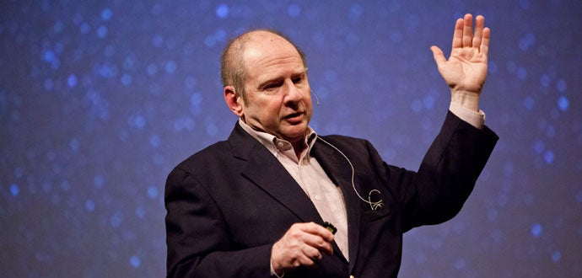
TO CONCLUDE
Writing clean code feels good and knowing how professionals are doing it helps us to write better code.
Programs must be written for people to read, and only incidentally for machines to execute.” ― Harold Abelson

Slide 28
BUILDING TESTS
Refactoring is a valuable tool, but it can’t come alone.
To do refactoring properly, I need a solid suite of tests to spot my inevitable mistakes.
Even with automated refactoring tools, many of my refactorings will still need checking via a test suite. I don’t find this to be a disadvantage.
Even without refactoring, writing good tests increases my effectiveness as a programmer.

Slide 29
THE VALUE OF SELF-TESTING CODE
If you look at how most programmers spend their time, you’ll find that writing code is actually quite a small fraction. Some time is spent figuring out what ought to be going on, some time is spent designing, but most time is spent debugging. I’m sure every reader can remember long hours of debugging—often, well into the night.
Every programmer can tell a story of a bug that took a whole day (or more) to find.

Slide 30
THE VALUE OF SELF-TESTING CODE
The event that started me on the road to self-testing code was a talk at OOPSLA in 1992. Someone (I think it was “Bedarra” Dave Thomas) said offhandedly, “Classes should contain their own tests.” So I decided to incorporate tests into the code base together with the production code.
As I was also doing iterative development, I tried adding tests as I completed each iteration.

Slide 31
THE VALUE OF SELF-TESTING CODE
I realized that, instead of looking at the screen to see if it printed out some information from the model, I could get the computer to make that test. All I had to do was put the output I expected in the test code and do a comparison. Now I could run the tests and they would just
print “OK” to the screen if all was well. The software was now self-testing

Slide 32
THE VALUE OF SELF-TESTING CODE
The resulting framework, called JUnit, has been extremely influential for program testing and has inspired a wide variety of similar tools in many different languages.
Admittedly, it is not so easy to persuade others to follow this path.
When tests are manual, it's annoyingly tedious.
But when they're automated, writing tests can actually be pretty fun.
In fact, one of the most useful times to write tests is before you start programming.
Kent Beck first turned this test-writing habit into a technique called Test Driven Development (TDD).

Slide 33
Make sure all tests are fully automated and check their own results.
A series of tests is a powerful bug detector that shortens the time it takes to find bugs.

Slide 34
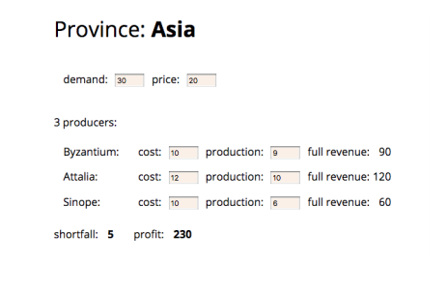
SAMPLE CODE TO TEST
The code supports a simple application that allows a user to examine and manipulate a production plan. The (crude) UI looks like this:

Slide 35
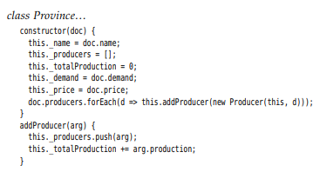
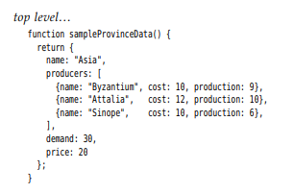
Here’s the code that loads the province from the JSON data:
This function generates the appropriate JSON data.
I can create a sample province for testing by creating a province object with the result of this function.

Slide 36
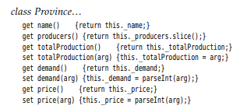
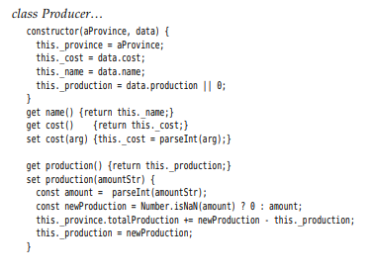
The Province class has accessors for various data values.
The setters will be called with strings from the UI containing the numbers, so I need to parse the numbers to use them reliably in calculations.
The producer class is mostly a simple data owner:

Slide 37
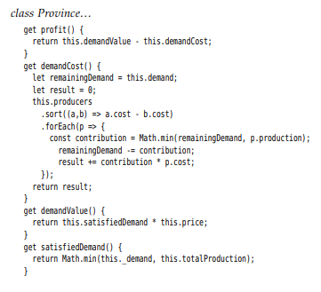
The way the generation set updates the derived data in the state is ugly and I want to refactor it.

Slide 38
A FIRST TEST
To test this code, I’ll need some sort of testing framework.
The one I’ll use is Mocha [mocha], which is reasonably common and well-regarded.
You should be able to adapt, easily enough, a different framework to build similar tests.
The key point is that I can quickly see if my tests are all OK.

Slide 39

A FIRST TEST
Here is a simple test for the shortfall calculation:
The Mocha framework divides up the test code into blocks, each grouping together a suite of tests.

Slide 40
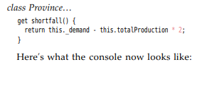
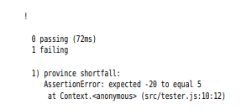
A FIRST TEST
When I write a test against existing code like this, it’s nice to see that all is well—but I’m naturally skeptical. Particularly, once I have a lot of tests running, I’m always nervous that a test isn’t really exercising the code the way I think it is, and thus won’t catch a bug when I need it to. So I like to see every test fail at least once when I write it. My favorite way of doing that is to temporarily inject a fault into the code, for example:

Slide 41
A FIRST TEST
In a real system, I might have thousands of tests. A good test framework allows me to run them easily and to quickly see if any have failed. This simple feedback is essential to self-testing code. When I work, I’ll be running tests very frequently—checking progress with new code or checking for mistakes with refactoring.

Slide 42
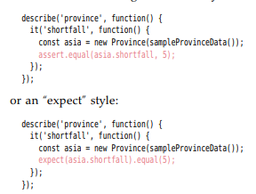
The Mocha framework can use different libraries, which it calls assertion libraries, to verify the fixture for a test.
The one I’m using at the moment is Chai [chai]. Chai allows me to write my validations either using an “assert” style:

Slide 43
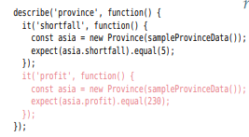
ADD ANOTHER TEST
I will start by hitting the other main output of this code, namely the profit calculation.
Again, I'll do a basic test for profit on my first fixture.

Slide 44
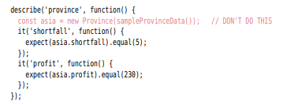
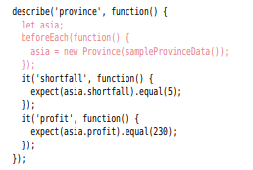
One option is to raise the constant to the outer scope.
The const keyword in JavaScript only means the reference to asia is constant, not the content of that object. Should a future test change that common object, I will end up with intermittent test failures due to tests interacting through the shared fixture, yielding different results depending on what order the tests are run in.
Instead, I prefer to do this:

Slide 45
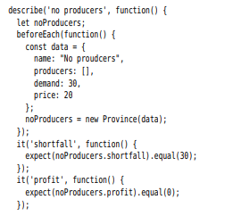
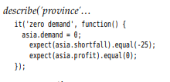
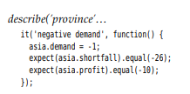
PROBING THE BOUNDARIES
Whenever I have a collection of something, such as producers in this example, I like to see what happens when it’s empty.

Slide 46
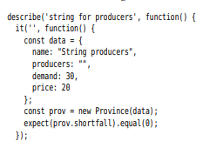
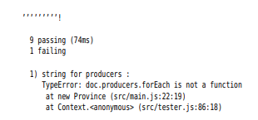
PROBING THE BOUNDARIES

Slide 47
INTRODUCING THE CATALOG
Each refactoring has five parts, as follows:
I begin with a name. The name is important to building a vocabulary of refactorings. Refactorings often go by different names now, so I also list any aliases that seem to be common.
I follow the name with a short sketch of the refactoring.
This helps you find a refactoring more quickly.
The motivation describes why the refactoring should be done and describes circumstances in which it shouldn’t be done.
The mechanics are a concise, step-by-step description of how to carry out the refactoring.
The examples show a very simple use of the refactoring to illustrate how it works.

Slide 48
SOURCE
Refactoring Improving the Design of Existing Code by Martin Fowler (z-lib.org) (1).pdf
https://ehsangazar.com/refactoring-bad-smells-in-code-8c8eccad9833
https://handeebrar.medium.com/bad-smells-in-code-refactoring-b110d2298923

